Slide 1
Group Portrait Maker Grove OZ Biz, LLC
The Creation of
Artistically Rendered Group Portraits of Family, Friends, Teams, Etc. through
Generative Adversarial Neural Networks (GAN)
Given a group selfie or family portrait, Group Portrait Maker (GPM) is a synthetic image generator app that recognizes people in any photograph, deconstructs each person into an individual object, recognizes facial features and fashion elements, generates a 3D humanoid model, reassembles the group and renders the group portrait in an artistic style. Since each person is now a 3D rigged humanoid avatar, the group’s pose can be edited or animated. New groups can be assembled from the user’s database of family, friends, colleagues, etc. Everyone is a member of multiple groups – families, teams, clubs, squads, etc. Grove OZ Biz’s motto is “Everyone on planet earth already wants more than one.”
See: groupors.com
www.groupors.com
2022

Slide 2
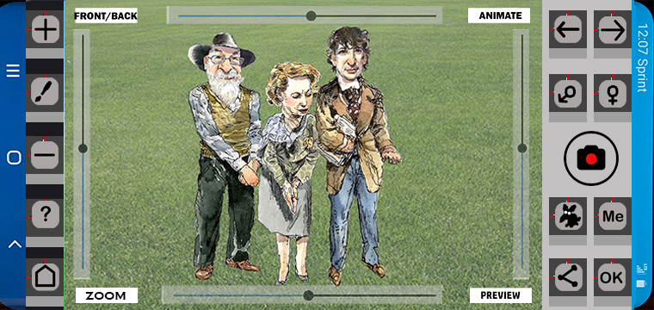
Users: Billions
3D Models
Various artists
GAN
CNN
Viral
Family, clubs, teams, groups
A phone app for artistically rendered group portraits
Sketch
May 2022

Slide 3
“Everybody on planet Earth already wants more than one.”
Basic Idea: an interactive phone app for creating artistic, group portraits from selfies.
Potential Customer Base: Everyone with a connected digital device on the planet
Market: Family, teams, clubs, squads, etc.
Focus Group: History- Concept successfully tested in over 50 in person sessions.
Enabling Technology: Convolutional & Generative Adversarial Neural Nets; DALLE.2
IPR: Specialized neural net for person recognition & 3D humanoid generation; business method;
Business model: Massive website traffic has value; & printed images as a product
Completed as of now: basic business structure, mockups, DB ERD, feature list, etc.
People: existing key persons and future team requirements TBD.
Funding: submit to Epic’s Mega Grant competition. https://www.unrealengine.com/en-US/blog/epic-games-provides-over-42-million-in-epic-megagrants
Next steps: Assemble team, Develop the MVP, Protect IPR & Secure funding

Slide 4
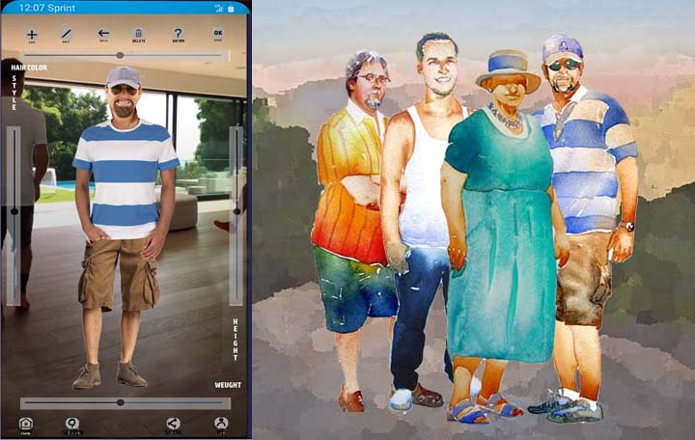
We all belong …
Family
Friends
Community
Teams
Clubs
Squads
Platoons
Board
Troop
Tribe
Posse
From a selfie to an artistic, group portrait instantly.
Basic Idea

Slide 5
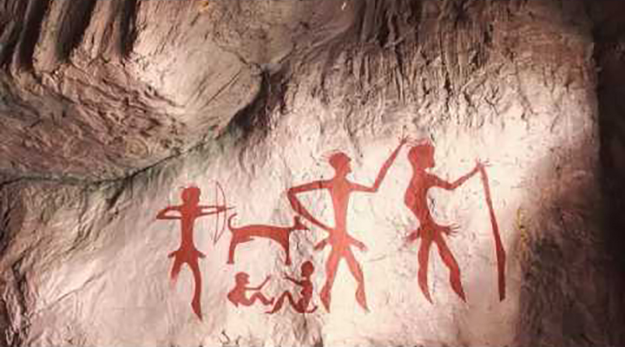
Billions
Long History
Formal
Casual
Crazy
Instant
Prehistoric origins
A very long history
just a step below food, shelter, sex
Chauvet-Pont-d'Arc Cave
Market
32,000 BC

Slide 6
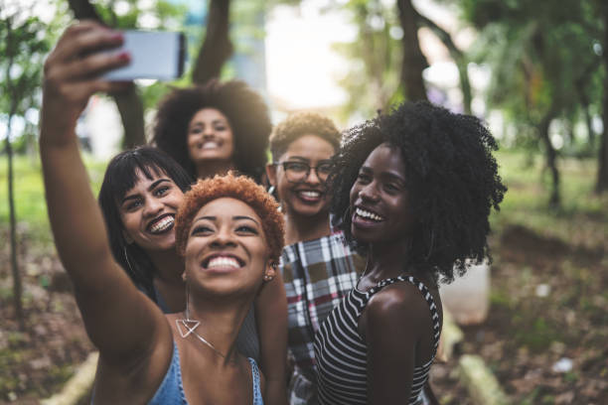
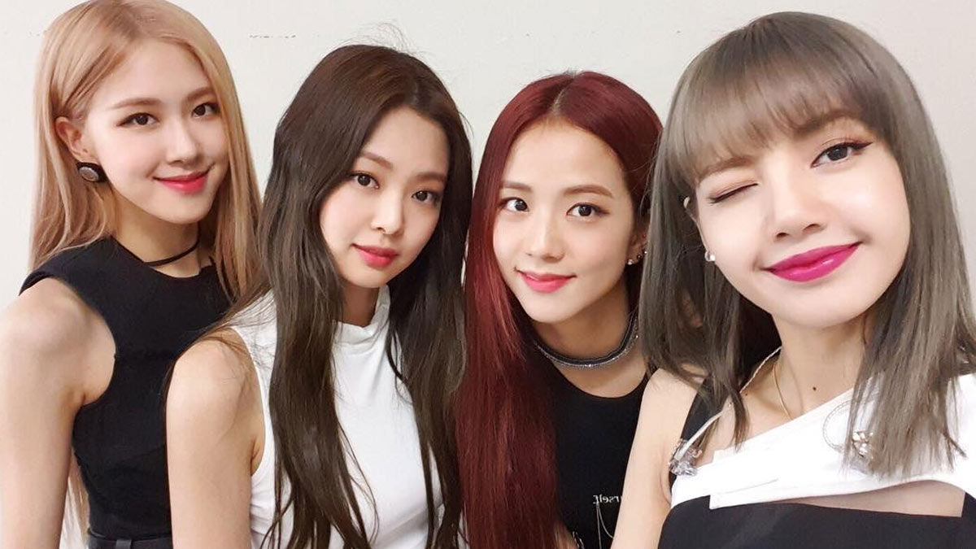
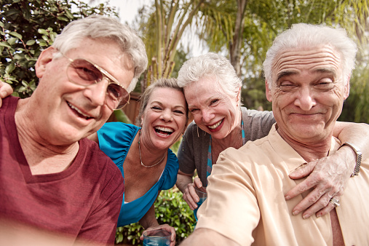
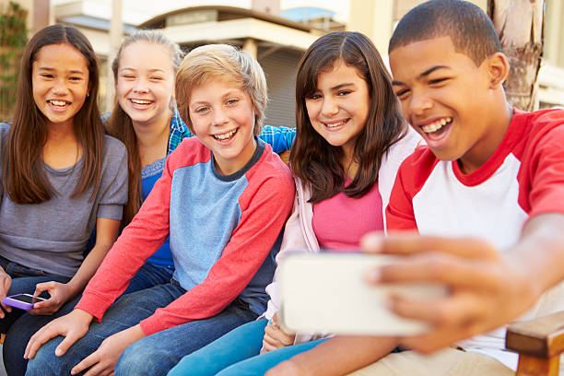
Cross-cultural, cross-linguistic, cross-generational
Potential global market
Market
2022

Slide 7
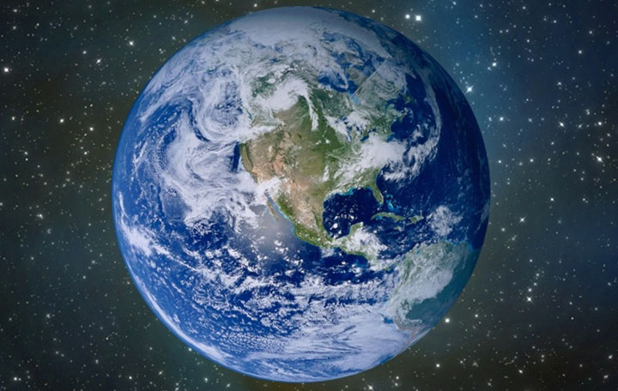
Customer Base:
4 billion
Internet users
Everybody on the planet Earth already wants more than one.
Market

Slide 8
Process
Capture or load any selfie or photo;
Recognize head, body, garments;
Process 3D avatar
Edit model in Person Editor
Swap fashion items
Display in Group Editor
Add people
Edit group
Add background
Print, share, save
From selfie to artistically rendered group portrait
Process

Slide 9
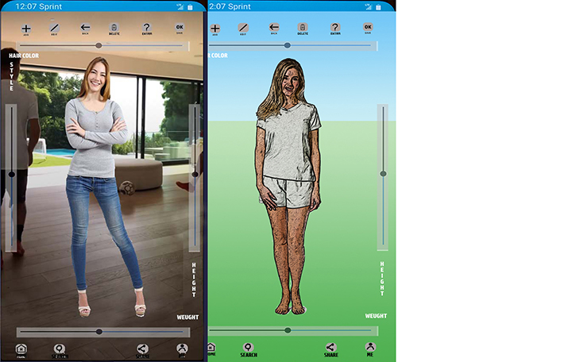
Process
Capture selfie
Generate 3D model
Edit base 3D avatar
Everyone in their underwear
From selfie to artistically rendered group portrait
Process

Slide 10
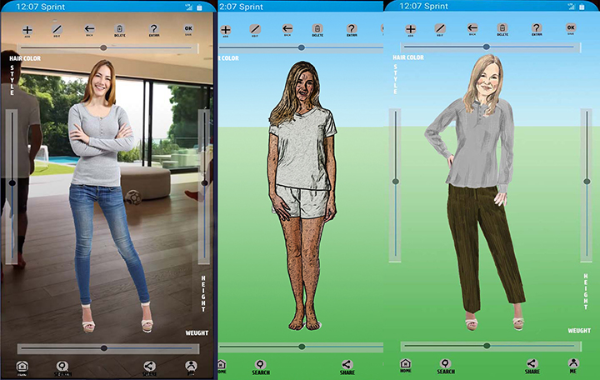
Process
Capture selfie
Generate 3D model
Generate dressed avatar
From selfie to artistically rendered group portrait
Process

Slide 11
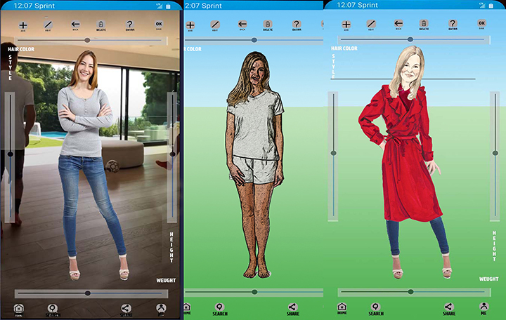
Process
Capture selfie
Generate 3D model
Generate dressed avatar
Edit fashion
From selfie to artistically rendered group portrait
Process

Slide 12
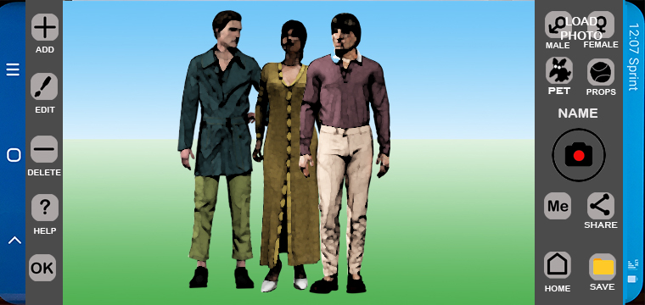
Assign Garments
Select PERSON
Select garments
Select artistic style
Pose group
Edit and render a variety of fashion styles and poses
Fashion

Slide 13
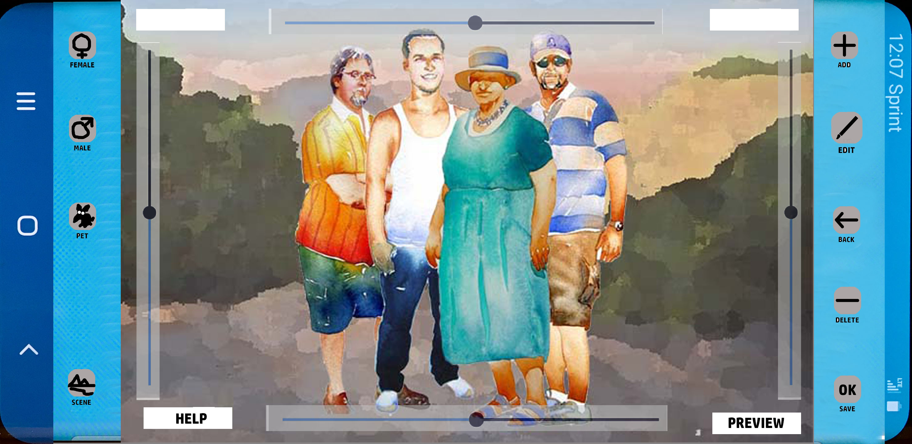
Process
Person Editor
to
Group Editor
Add persons
From selfie to artistically rendered group portrait
Process

Slide 14
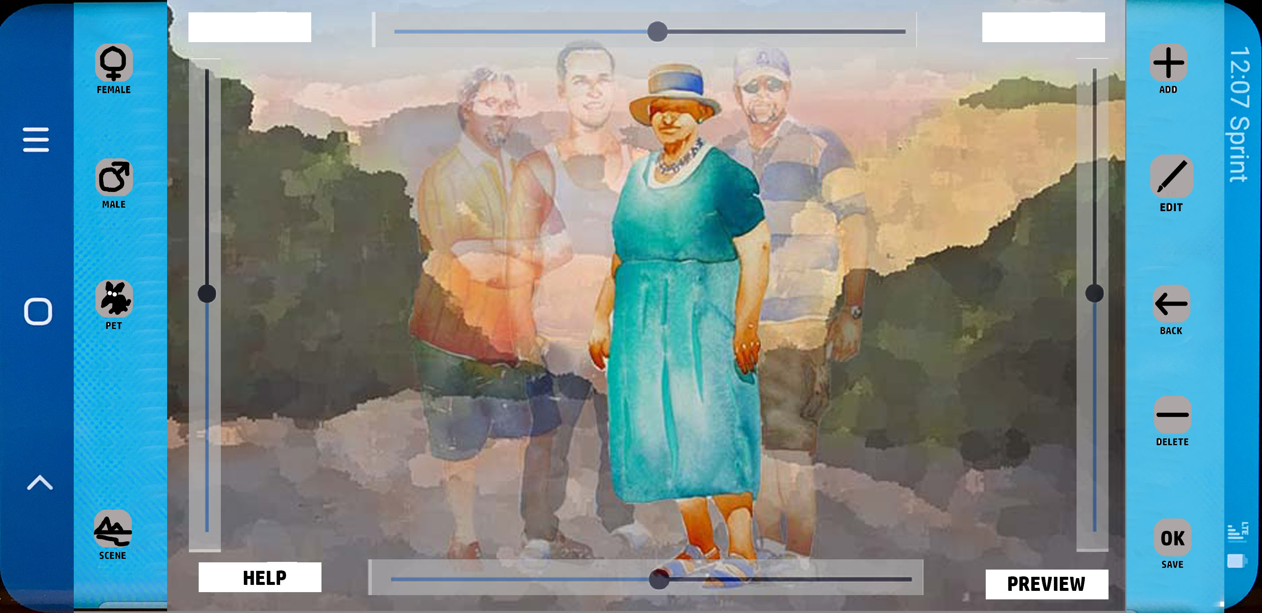
Process
Person Editor
to
Group Editor
Add person
Select person for editing
Arrange order, orientation, etc
SCENEeditor
Process

Slide 15
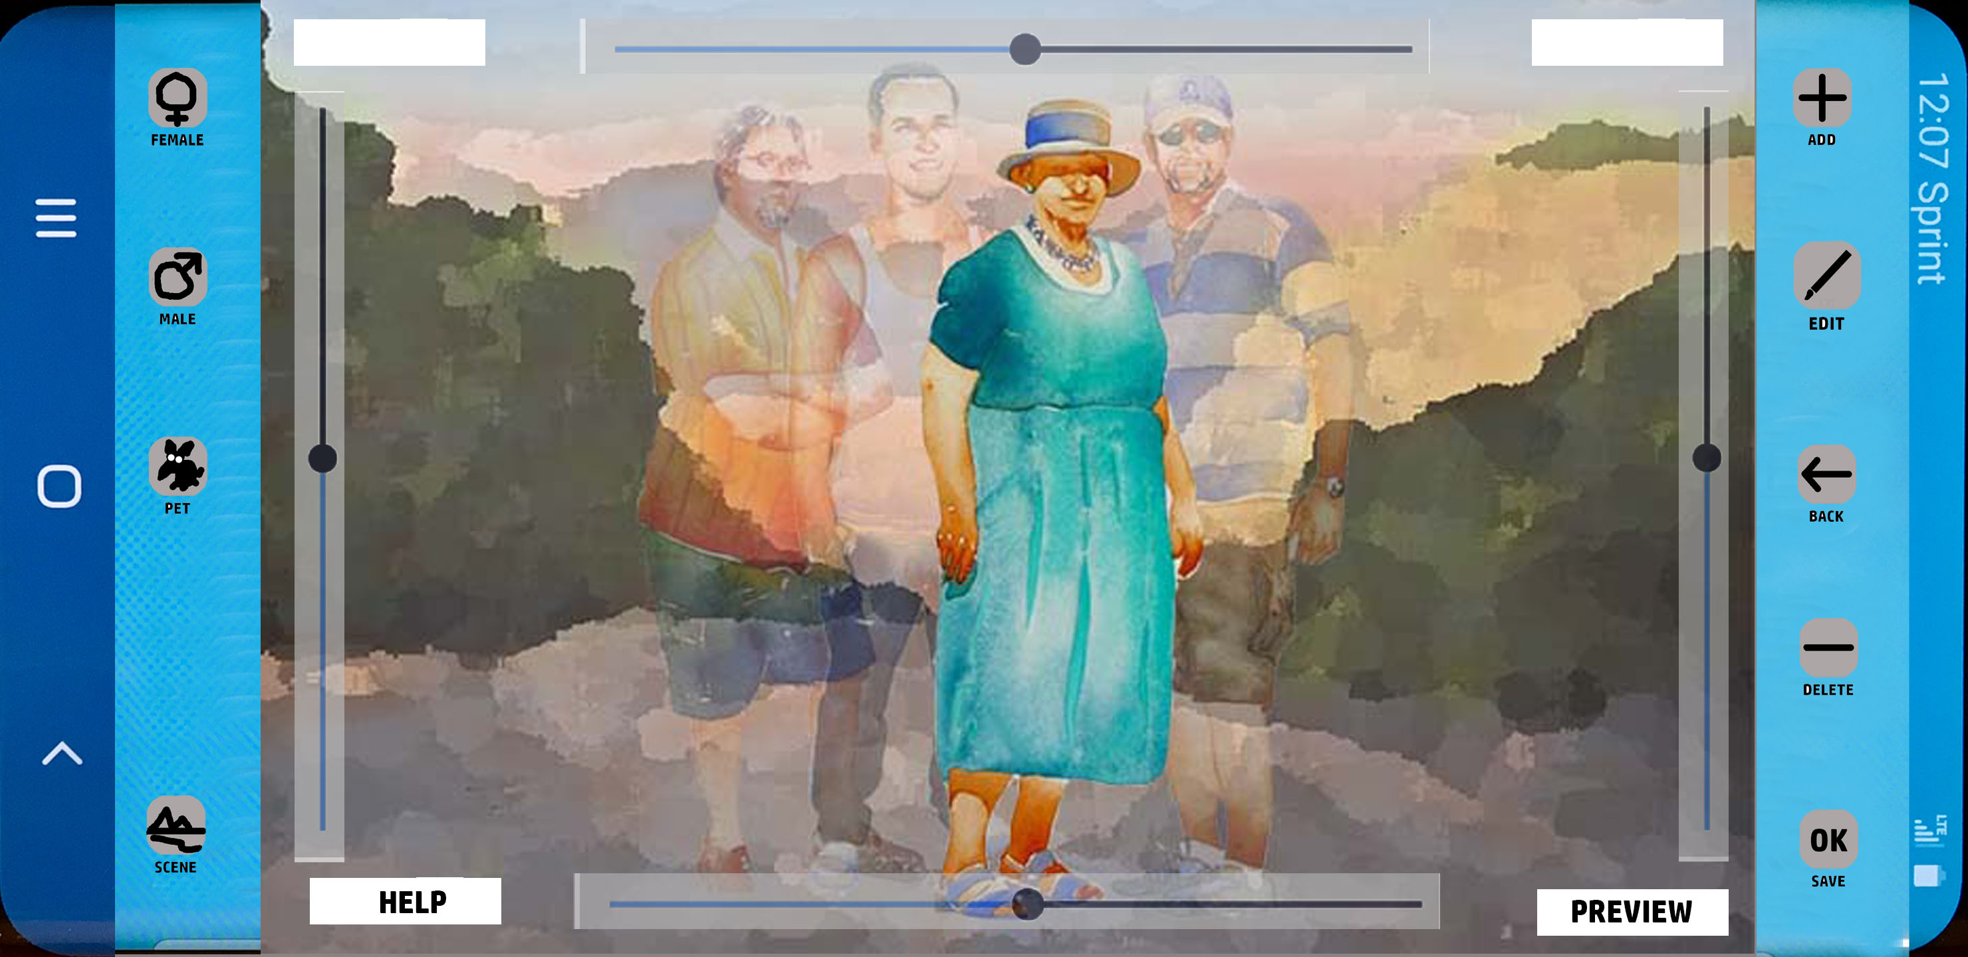
Process
Person Editor
to
Group Editor
Add person
Select person for editing
SCENEeditor
Process

Slide 16
Process
Person Editor
to
Group Editor
Add person
Select person for editing
Arrange order, orientation, etc
SCENEeditor
Process

Slide 17
Process
Person Editor
to
Group Editor
Add person
Select person for editing
Arrange order, orientation, etc
Exit edit mode
SCENEeditor
Process

Slide 18
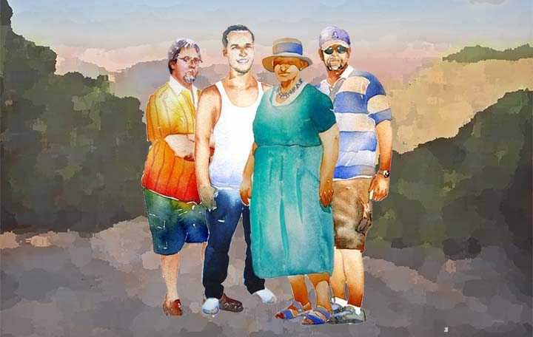
Products
Viral traffic
Paper Prints
Media shares
Facebook
Instagram
What’sApp
LinkedIn
Tee Shirts
Ceramics
Fashion sales
Final Product: High resolution full color image suitable for sharing & output.
Product

Slide 19
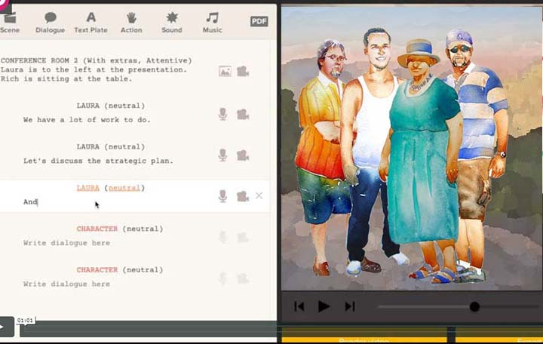
Products
Animated video
Text to speech
Similar to Plotagon
plotagon.com
Ultimate Final Product: Scripted, animated videos
Product

Slide 20
Distinctive Qualities & Features
Bits not atoms: Totally digital product
No known competition: Artistic Group Image Generation is unique
Everyone with a connected, digital device is a customer: Global
Customers are likely to want more than one: Everyone has multiple groups
Teams, families, clubs, squads, platoons, friends, boards, councils, etc.
Inherently viral: as compelling as TikTok
Fashion is a major marketing component: potential marketing deals
Artistic drawing approach negates photorealism: perception of precision
The whole group is the product: Faces are secondary
Much of the technical invention has been done: Novel use of existing tech
Completed Now

Slide 21
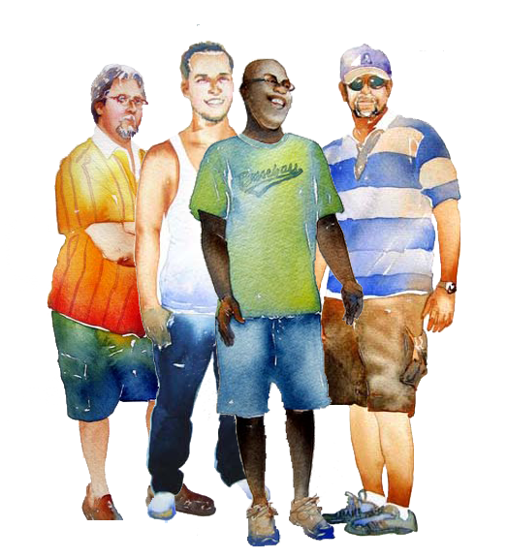
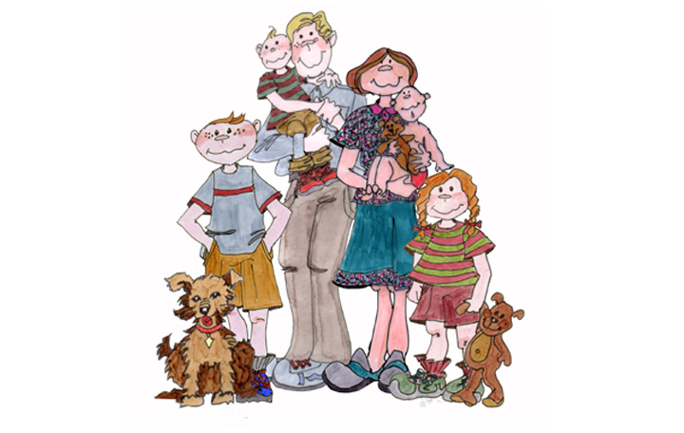
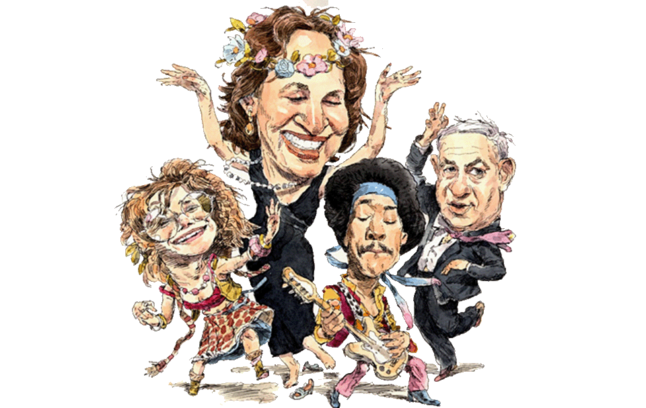
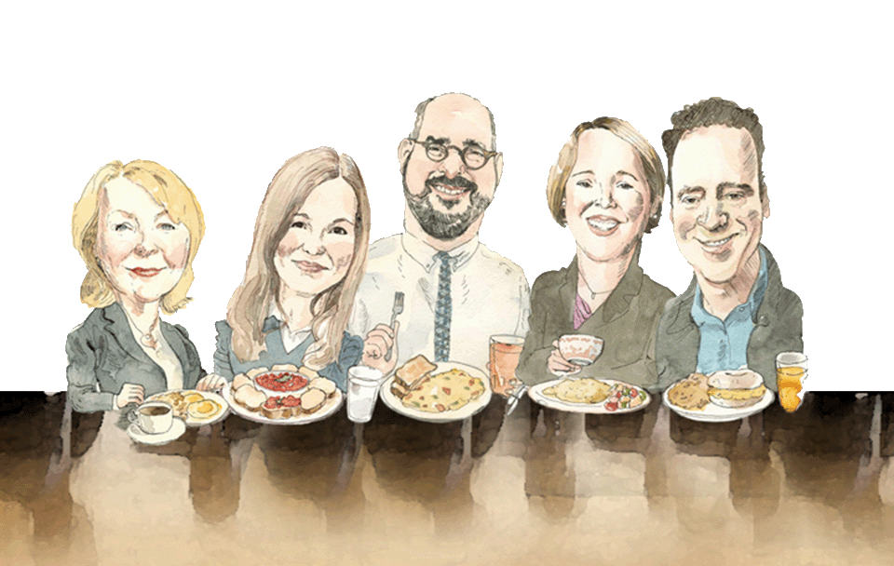
In the Style of …
Many different artists
Artistic Styles

Slide 22
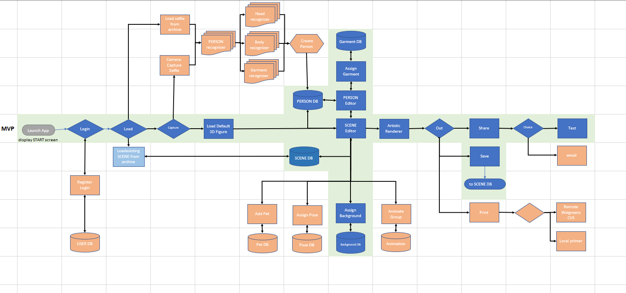
Person editor
Group editor
Artistic renderer
Output options
Group Portrait Maker Pipeline; First components developed
2021

Slide 23
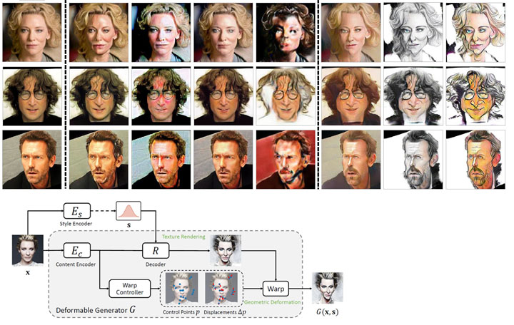
WarpGAN
Open source
U of Michigan
The generator module of WarpGAN. Given a face image, the generator outputs an image with a different texture style and a set of control points along with their displacements. A differentiable module takes the control points and warps the transferred image to generate a caricature.
E.G. Many processes in the pipeline exist and are open source.
Generative Adversarial Neural Network (GAN)
Artistic Styles

Slide 24
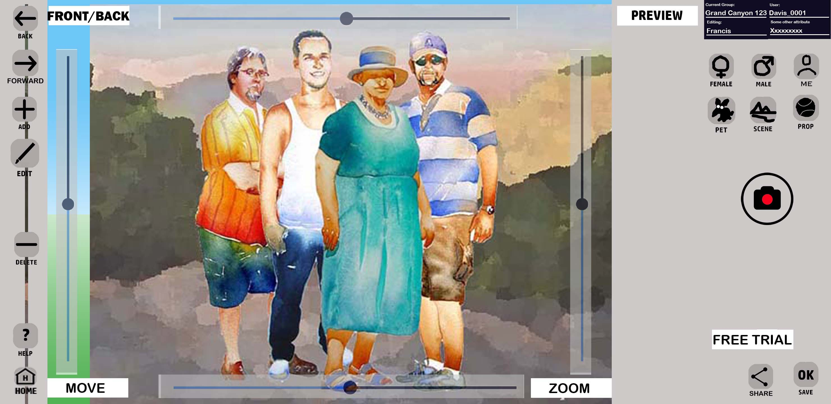
Early draft of group editor based on screen layout of other existing phone apps.

Slide 25
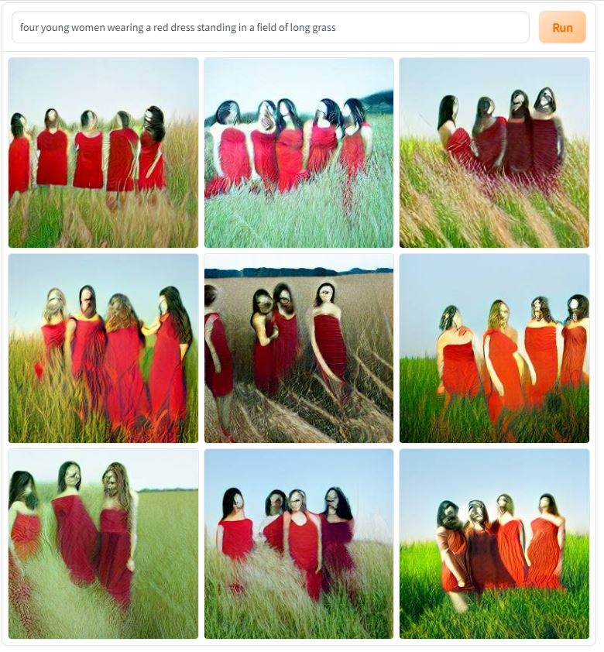
Alternate technology
DALLE.2
MidJourney
Stability AI
In the spring of 2022, the DALLE image generator was published and later Google’s Imagen. These neural networks have a huge source database and are capable of generating new synthetic images from a simple text string.
Speech to text to image is possible. Then soon … to 3D.
The example to the left took one minute to generate, but still too imprecise for this project.
Text string: “four young women wearing a red dress
standing in a field of long grass.”

Slide 26
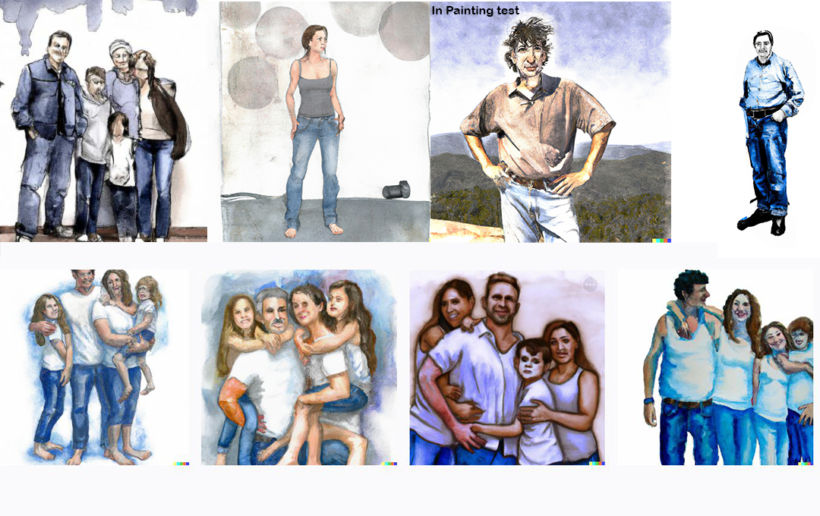
Diffusion Models
DALLE.2
MidJourney
Stability AI
Diffusion models offer a significant advancement in generating group portraits compared to a procedural technique. A much broader set of outcomes is possible with minor edits to the text prompts. Precise control of the results is a current challenge. In painting might enable better results.
Text string: “family of four wearing white tee shirts and blue jeans.”

Slide 27
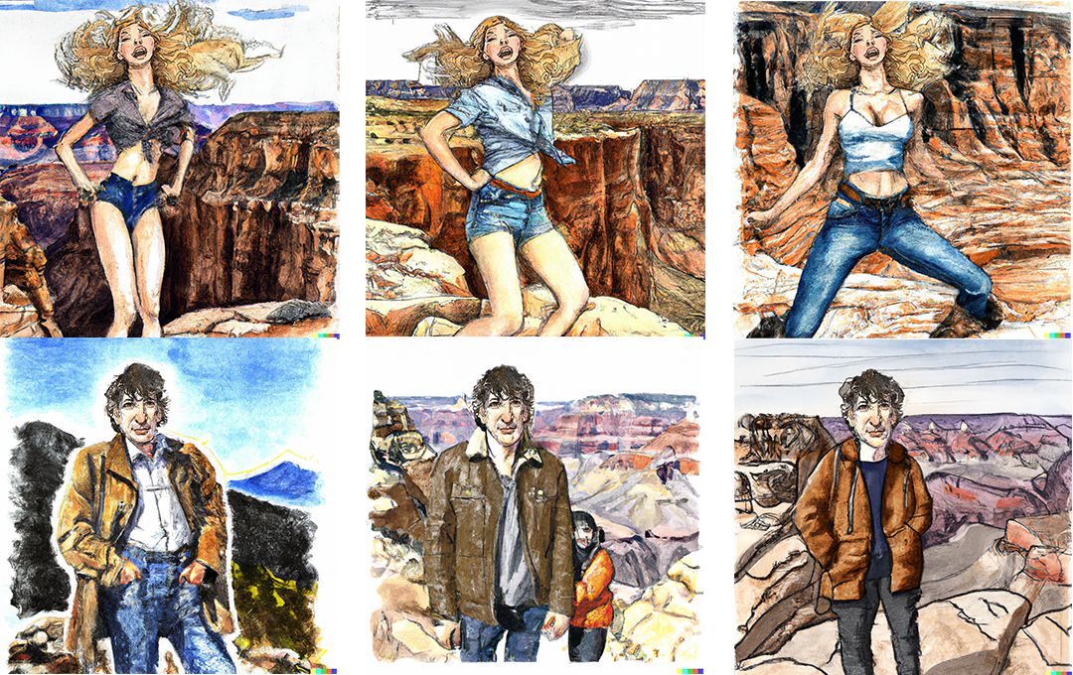
Diffusion Models
In-painting examples
DALLE-2
In painting offers some additional control for GPM characters. These faces were generated by warpGAN and assigned to the DALLE body results. More experimenting is needed for better control.
Some technique for enabling user edits to the garments is a current challenge.
Text string: “young woman with long blond hair wearing a tank top and jeans dancing at the Grand Canyon.”
And: “young man wearing a brown leather jacket and blue jeans at the Grand Canyon

Slide 28
Next Steps
Write Opportunity Zone plan
Update business plan
Embellish user requirements and write specifications
Complete development of sketch phone mockup with Adobe XD
Develop early GAN procedures to test viability of basic functions
Continue to assemble development team; small, agile, smart
Contact Browzwear
Complete MVP; Seek funding
Test MVP with focus groups
Submit to: https://www.unrealengine.com/en-US/blog/epic-games-provides-over-42-million-in-epic-megagrants
Next Steps

